Slide 1
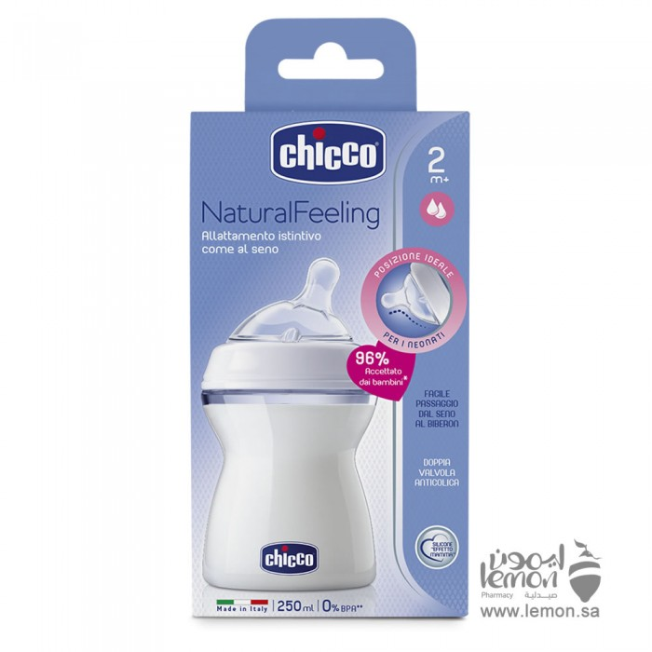
Child care
Baby bottles
ChicoChicco baby feeding natural feeding simulator breastfeeding 250ml normal flow older than two months
53.16 R.S
Chicco natural feeding breastfeeding simulator 250 ml normal flow larger than two months distinctive and practical where Chicco designed baby feeding simulates the mother's breast, which is great for babies during their growing period. It is known that the mother's breast perfectly adapts to the various sucking movements of the baby. The feeding nipple is therefore designed to adapt to these movements to significantly mimic breastfeeding.The nipple has a circular oblique design specially designed for newborn babies. Feeding is always full of milk, which reduces air swallowing thanks to the double valve. Such feeding ensures the correct position of the baby's neck during feeding. The nipple is fitted with astringent parts at the base which makes it very similar to the mother's breast and helps to greatly increase the elasticity of the nipple.

Slide 2
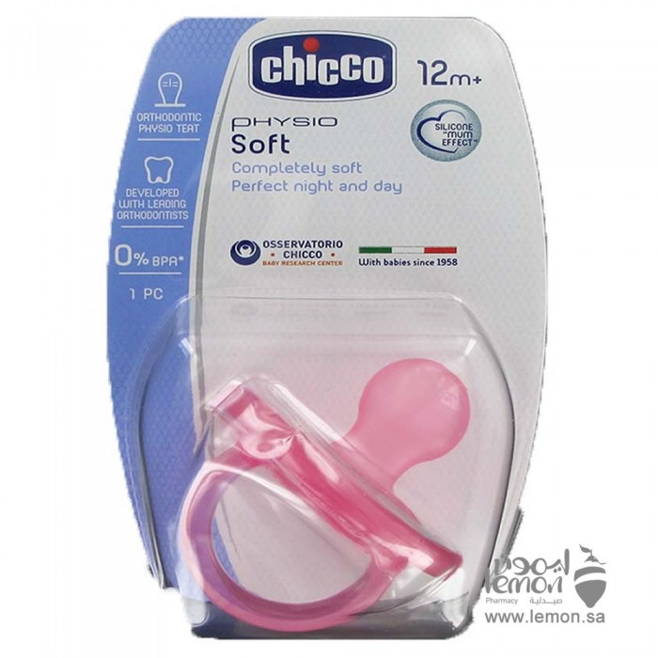
ChicoChicco silicone pacifier for children older than 12 months
28.62 R.S
Chicco silicone pacifier for babies older than 12 months with a unique design is fully soft and provides maximum comfort for the baby. Chicco pacifier is ideal for bedtime as it does not cause any discomfort to the baby. Comfortable and gentle on your baby's skin. Designed in collaboration with leading experts in the field of orthodontics. The small ripples and oblique nipple shape of the Chicco pacifier allow to maintain the natural posture and movements of the tongue while using the pacifier. The special shape of the nipple also allows the pressure of the tongue to be evenly distributed over the palate. The thin base provides additional flexibility and allows the mouth to be completely closed. This pacifier is madefrom transparent and healthy silicone, very soft and velvety to the touch without taste or smell.Note: The Shape of the box may change from the one in the picture due to constant updates from the manufacturer and the country of origin may change because there are more than one factory of the company in several countries around the world

Slide 3
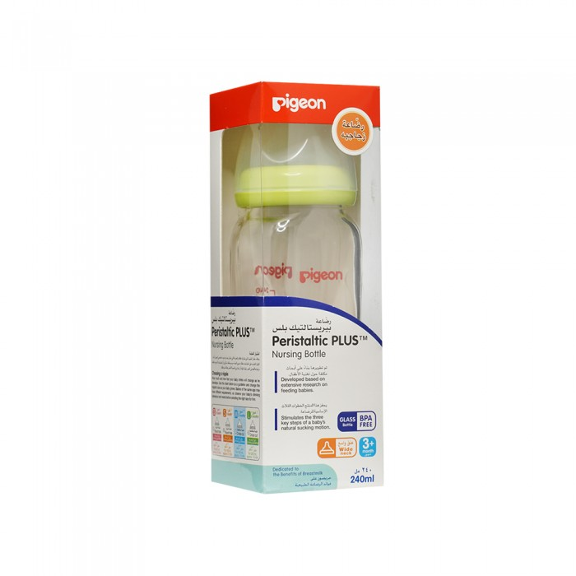
PigeonPigeon glass bottle 240 ml
56.35 R.S
High quality glass bottle, easy to sterilize, for multiple use

Slide 4
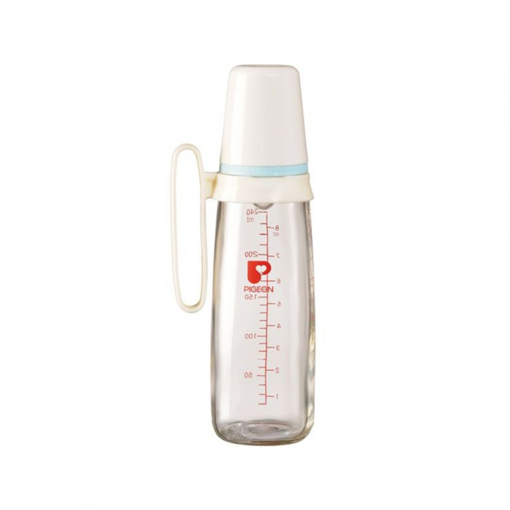
Pigeon
Pigeon glass bottle with hand holder 240 ml
49.45 R.S
High quality glass bottle, easy to sterilize, multi use

Slide 5
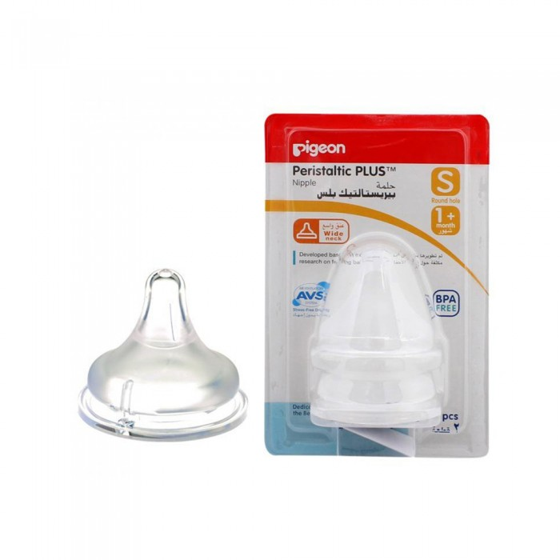
Pigeon
Pigeon small teat 2 tablets
33.35 R.S
The nipple section has an "accordion-like" part that enables it to stretch in response to the movement of the baby's tongue
.- The surface of the nipple is very soft, but it does not collapse easily. Made of super soft thick silicone material, the nipple has elasticity similar to that of the actual breast of the mother. The dome-like shape makes the baby's mouth naturally open, softly supports his mouth and gently fits his lips.

